Slide 1
Machine Learning
Guan Wang

Slide 2
Machine Learning Definitions
Machine learning is process (field of study) that gives computers ability to learn without being explicitly programmed.
A.L. Samuel Some Studies in Machine Learning Using the Game of Checkers // IBM Journal. July 1959. P. 210–229.
A computer program is said to be learn from experience E with respect to some task T and some performance measure P, if its performance on T, as measured by P, improves with experience E.
T.M. Mitchell Machine Learning. McGraw-Hill, 1997.

Slide 3
Required Background (Optional)
Probability theory and mathematical statistics
Optimization
Computational science
Linear algebra
Discrete math
Computational complexity theory
...

Slide 4
Machine Learning Problems
Supervised Learning
Unsupervised Learning
Semi-supervised Learning
Reinforcement Learning
Federate Learning
…

Slide 5
Supervised Learning
A set of examples with answers is given. A rule for giving answers for all possible examples is required.
Supervised algorithms are trained on labeled examples (samples), such as an input where the desired answer is known.
Classification
Regression
…
For example, a segment of text could have a category label, such as
Spam vs. Legitimate emails
Positive vs. Negative movie reviews

Slide 6
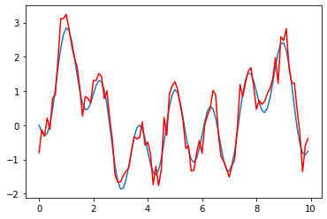
Supervised learning is commonly used in applications where historical data predicts likely future events.

